Slide 1

BT 101 - Engineering Biology
Department of Biotechnology

Slide 2
Unit I
Molecules of life, water and carbon - chemical basis of life, protein structure and function, nucleic acids and the RNA world, carbohydrates, lipids, membranes and first cells.

Slide 3
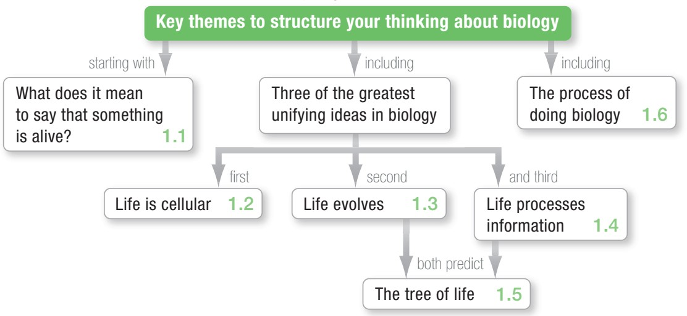
Biology and the Tree of Life

Slide 4
What is Life?
Origin of Life – Mystery
Life Processes / Properties?
5 Fundamental Characteristics
Cells
Replication
Evolution
Information
Energy

Slide 5
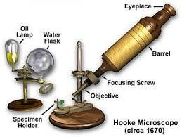
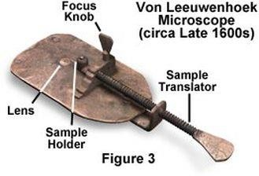
Cells – Life is cellular
Robert Hooke (1665) 30x
Anton von Leeuwenhoek 300x Animalcules
Italian plant biologists (1670)
1800s All organisms are made of cells
All the cells (inclusive of multicellular organisms) are connected by common ancestry
Where do cells come from?
Rudolph Virchow (1858) : Cell Theory – All cells come from pre-existing cells (Hypothesis)
Spontaneously Generation - Prevailing explanation

Slide 6
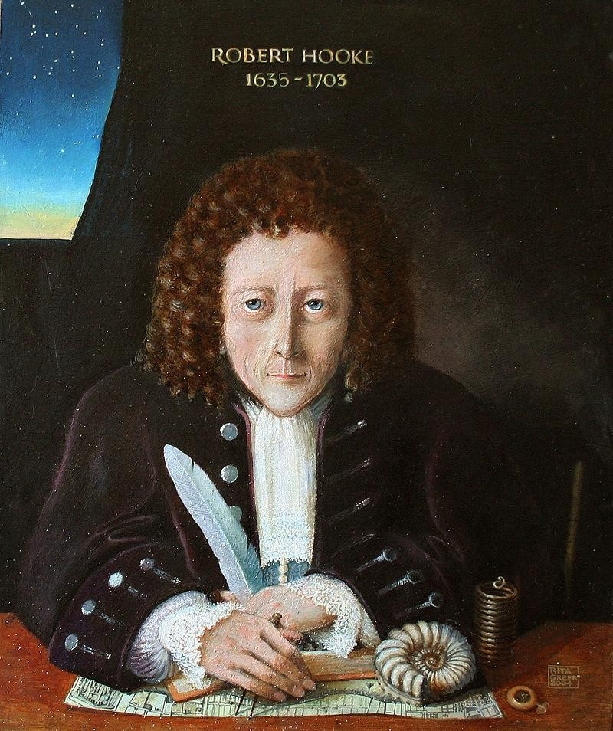
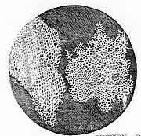
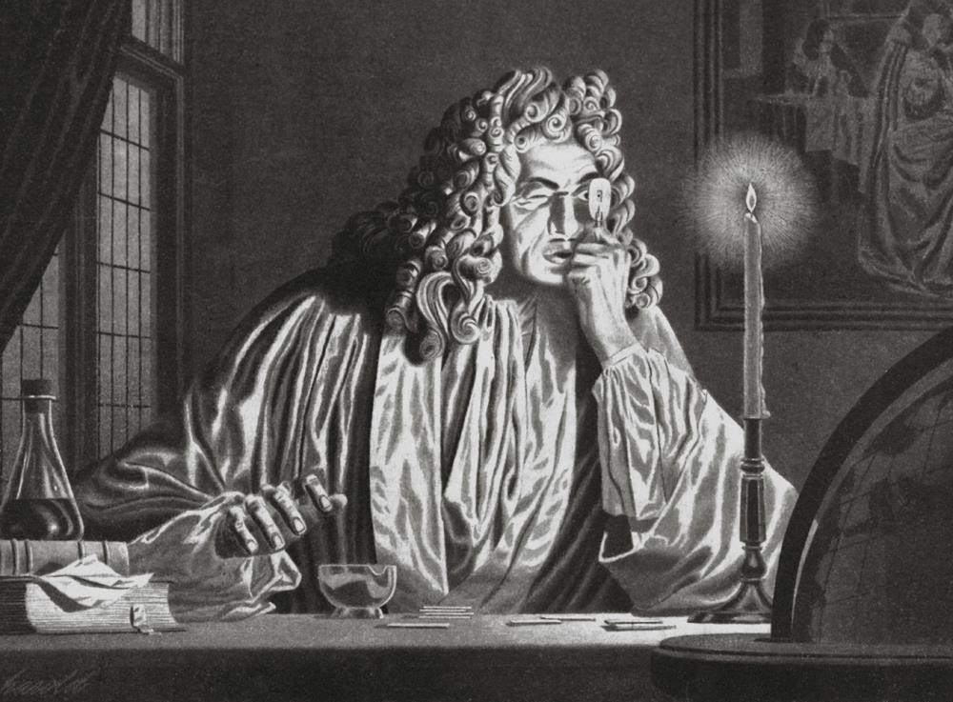
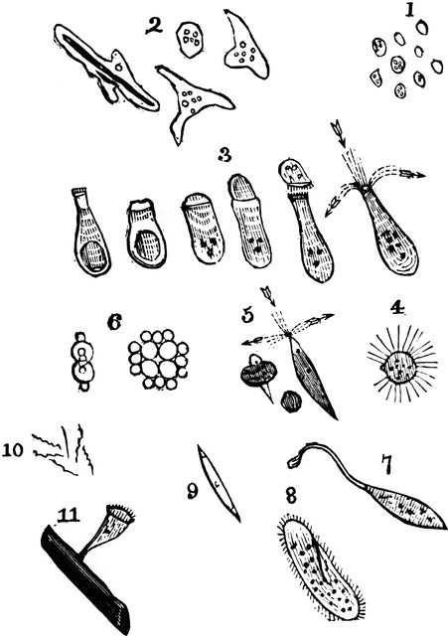
Anton van Leeuwenhoek

Slide 7
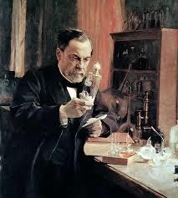
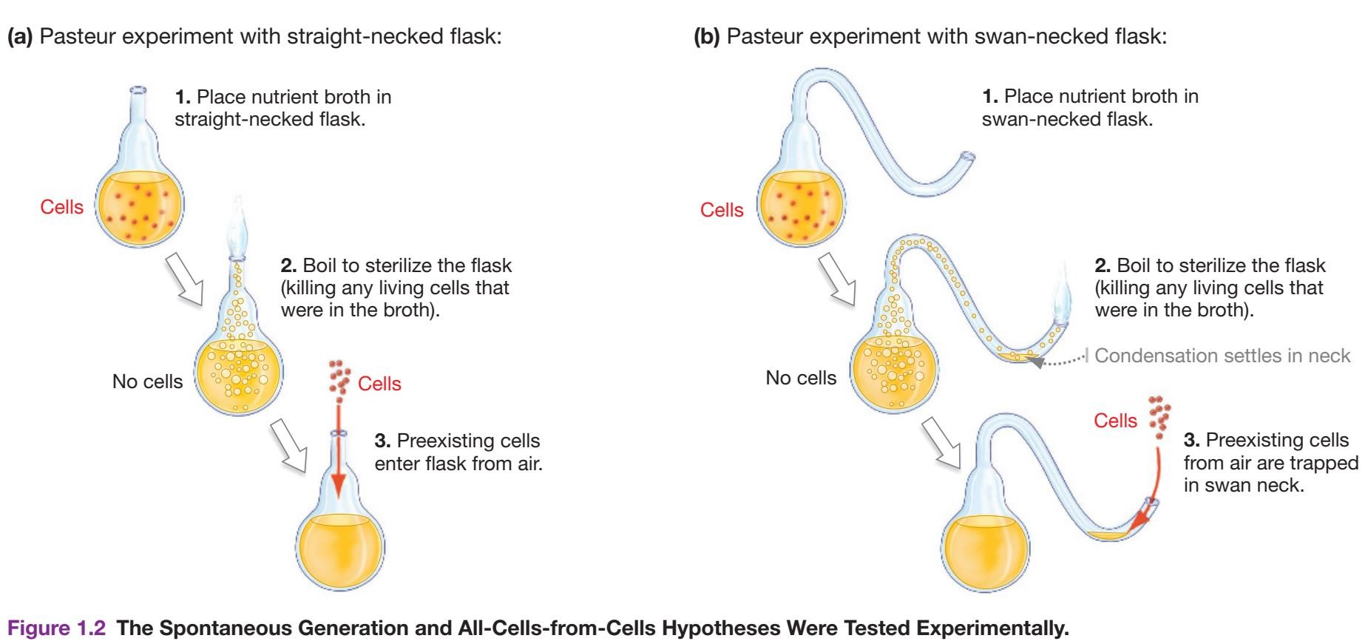
Louis Pasteur’s Experiments
Spontaneous generation DOES NOT OCCUR, however for Life to exist, spontaneous generation must have occurred AT LEAST ONCE in Earth’s history => CHEMICAL EVOLUTION

Slide 8
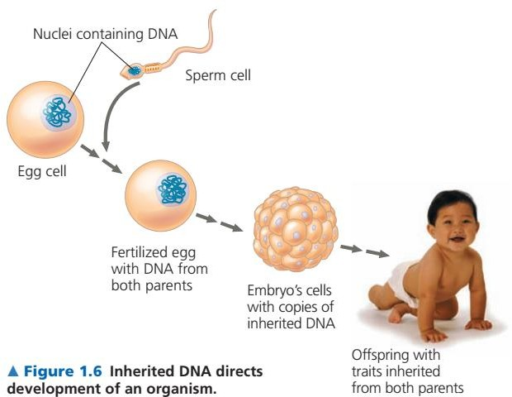
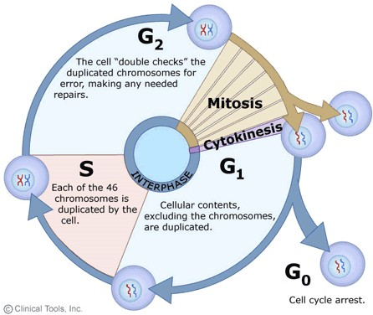
Life Replicates
Cellular division
All species trace their ancestry back to a single common ancestry – LUCA: Last Universal Common Ancestor

Slide 9
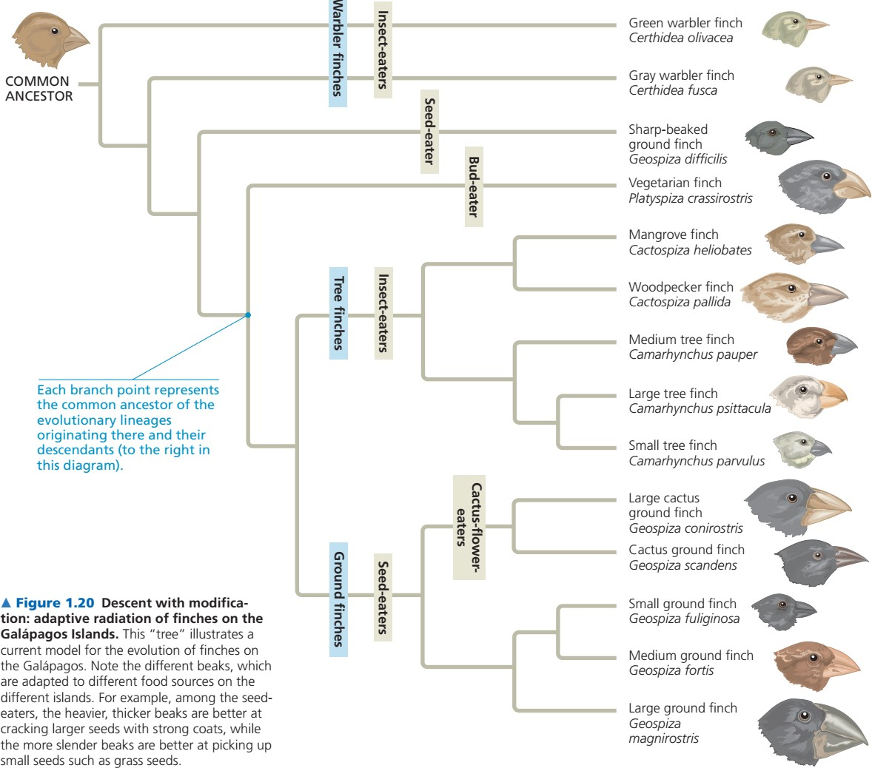
Life Evolves
Evolution by natural selection
Alfred Russel Wallace and Charles Darwin
Natural selection - works in individual organism
Evolutionary change occurs in population
Fitness: Ability of an individual to produce viable offspring
Adaptation: trait that increases the fitness of an individual in a particular environment
Speciation: divergence of species
All species trace their ancestry LUCA
Accounts for UNITY and DIVERSITY of life

Slide 10
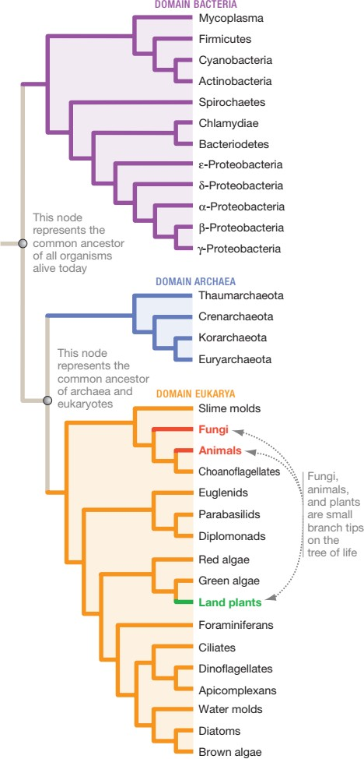
3 Domains of Life
Carl Woese & Colleagues
Sequencing data
Small subunit of ribosomal RNA (rRNA)
Phylogeny (tribe source)
Archaea – recent addition

Slide 11
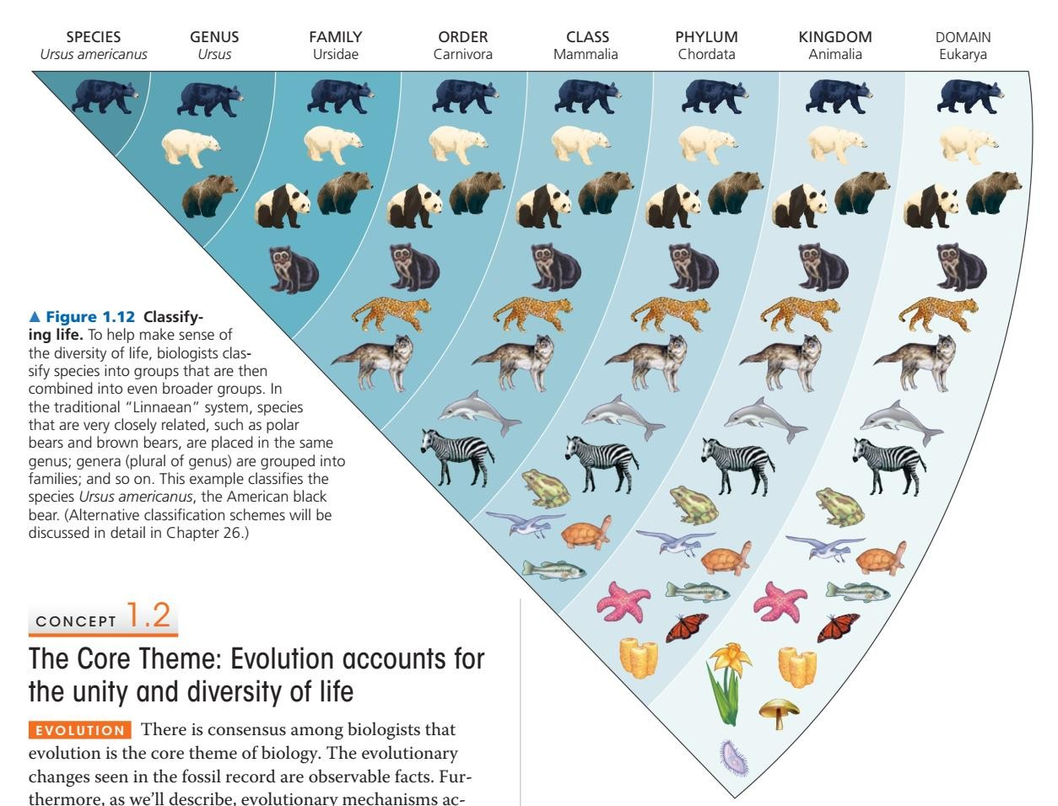
Scientific Names
Carolus Linnaeus
2 part unique name
Greek or Latin Roots
Homo – man
sapiens – wise / knowing Homo sapiens Saccharomyces cerevisiae
Saccharo – Sugar
myces – Fungus
cerevisiae – Beer

Slide 12
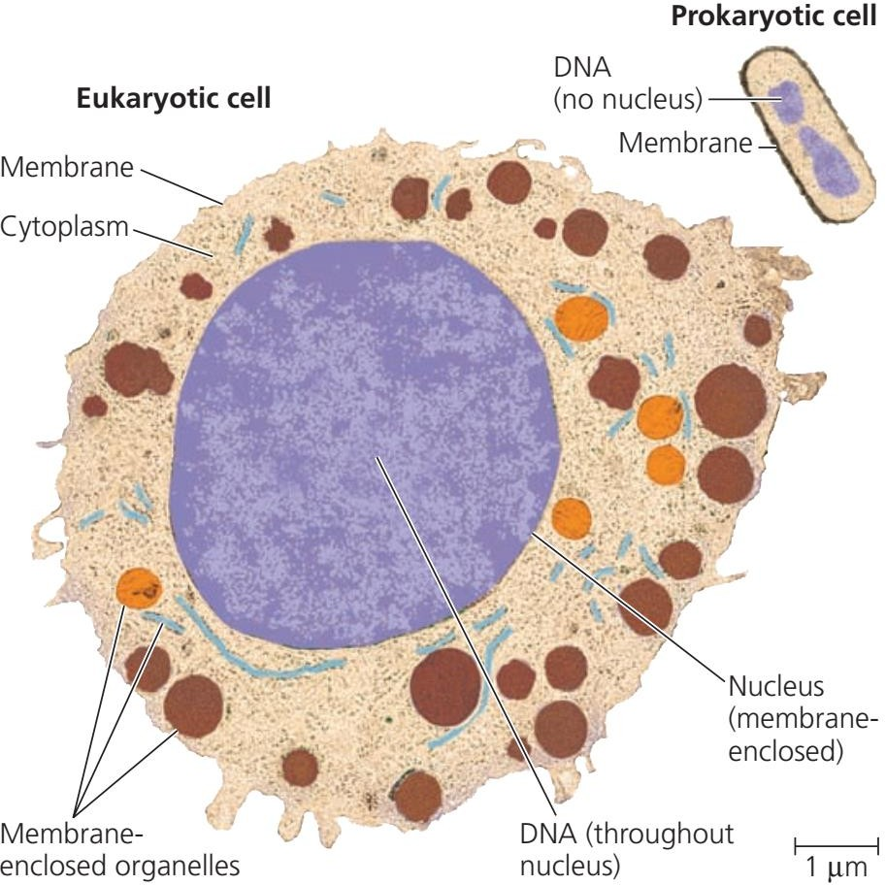
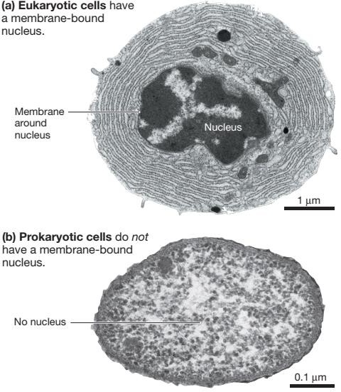
Eukaryotic Vs Prokaryotic

Slide 13
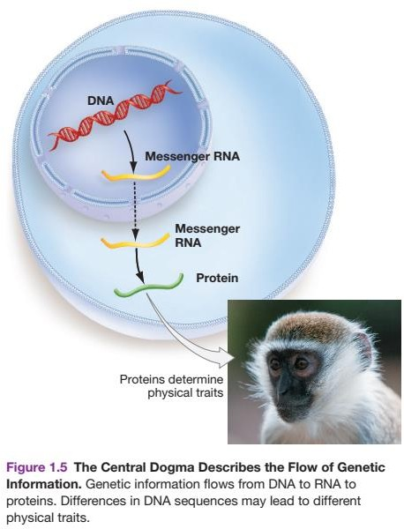
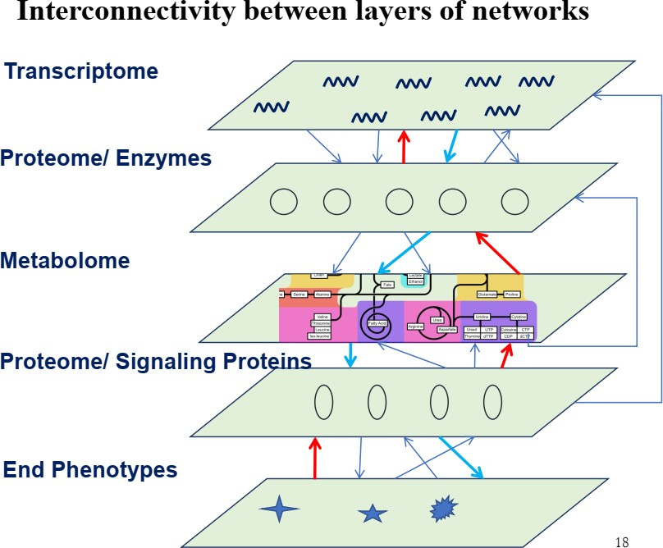
Life Processes Information
How cells do what they do?
Phenotype = f (Genotype, Interactions)

Slide 14
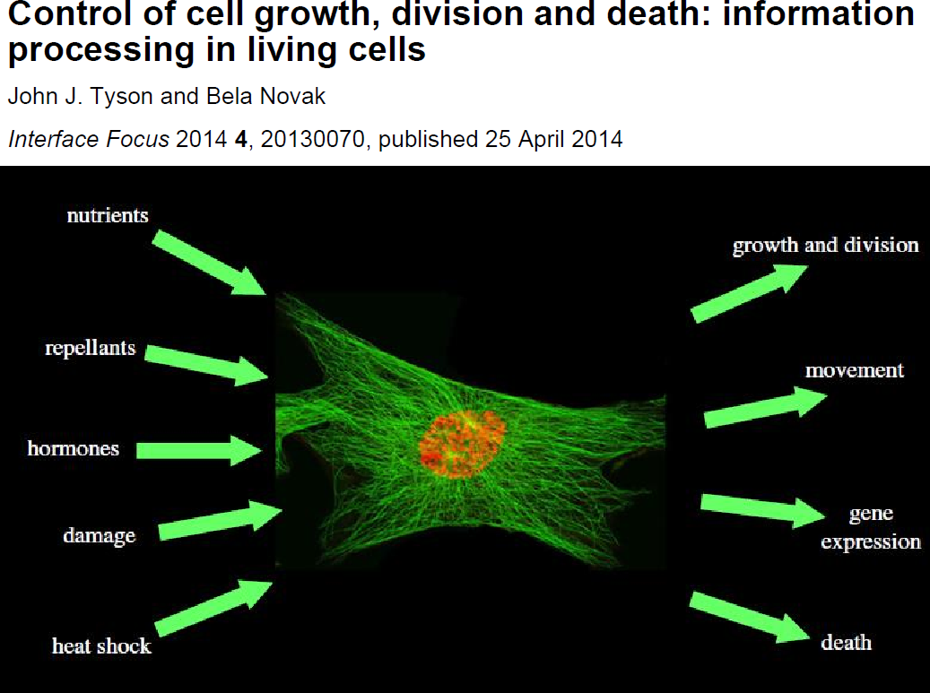
14

Slide 15
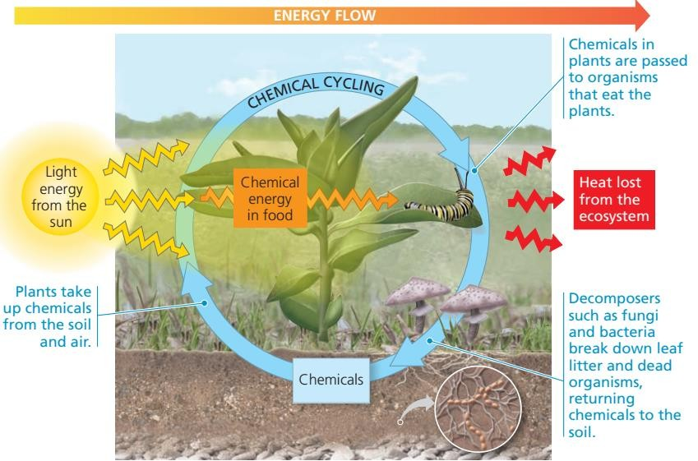
Life requires Energy
Active utilization of energy
Solar
Chemical
Food: Primarily Plants
Stored in high energy chemical bonds
Metabolic energy currency: ATP

Slide 16



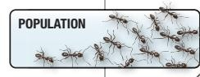
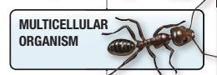
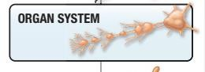
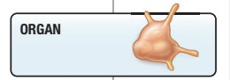
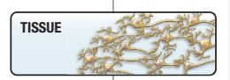
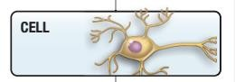
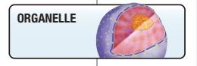
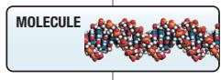
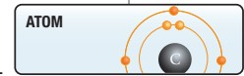
Biological organization

Slide 17
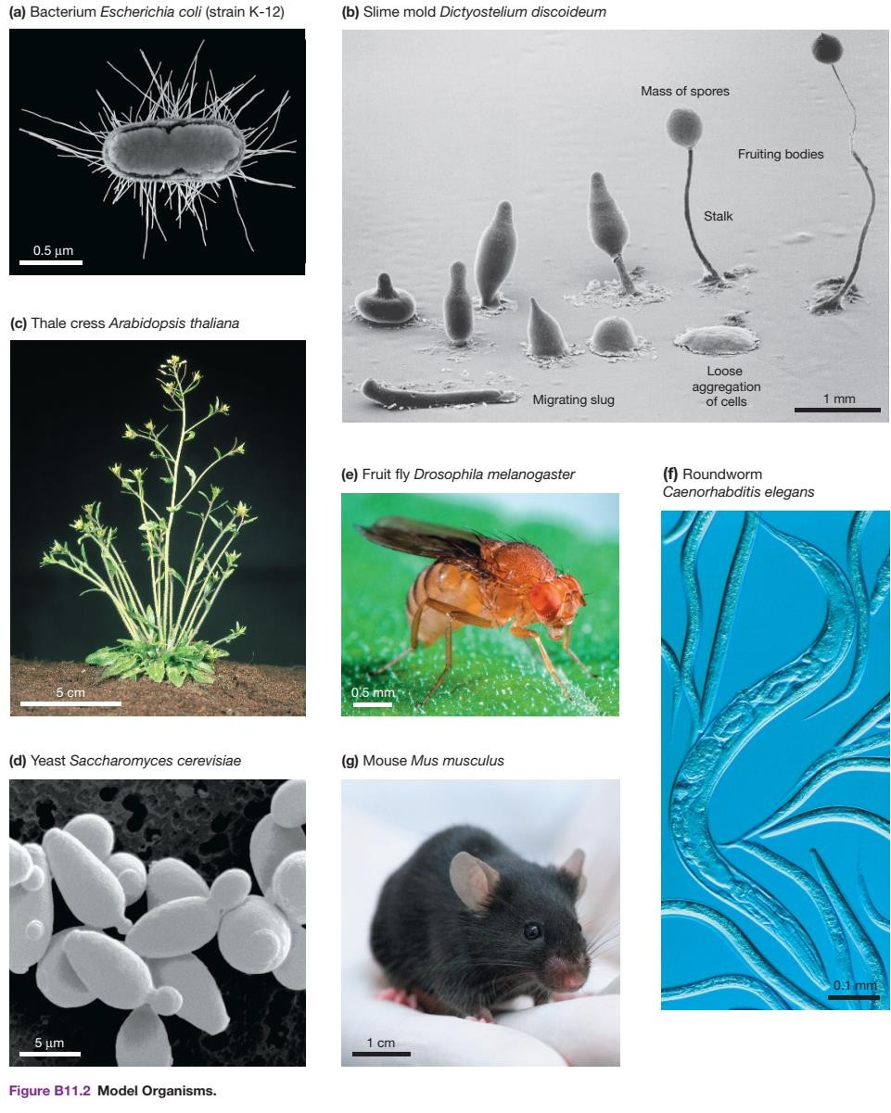
Model Organisms
Most of what we know today comes form studies with established model organisms

Slide 18
Water and Carbon
Water: Biological medium on earth
The abundance of water is the main reason the Earth is habitable
Cells contain 70-95% Water
Carbon: Small molecules, Complex carbon containing substances are essential for life
Role of Energy
Theory of Chemical Evolution: Molecules multiplied (Replicated) and
Evolution by Natural selection took over (Switch)
Organic molecules became Metabolically active and Acquired a membrane => Life Began
What evidence do biologists have that chemical evolution occurred?

Slide 19
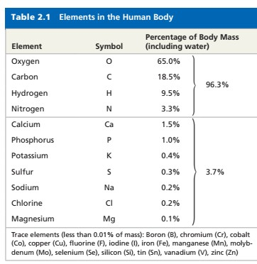
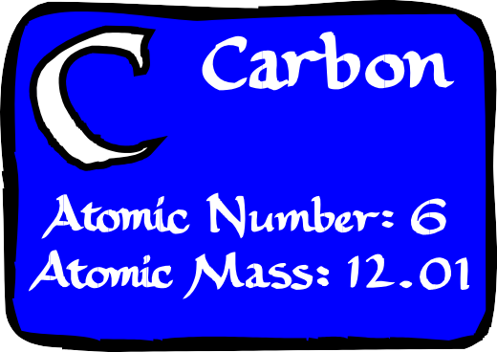
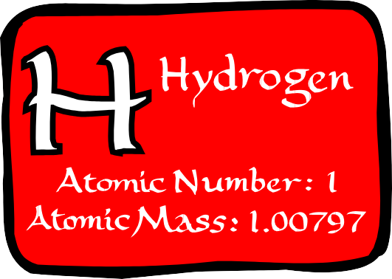
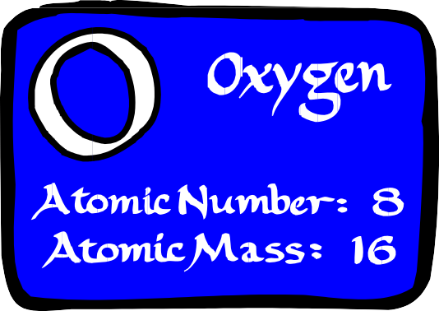
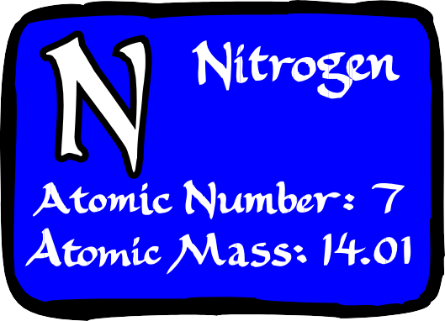
The Molecules of Life
Building blocks of Chemical Evolution: H₂O, CO_{2,} NH_{3,} etc..
What is the structure…..??? affects function

Slide 20
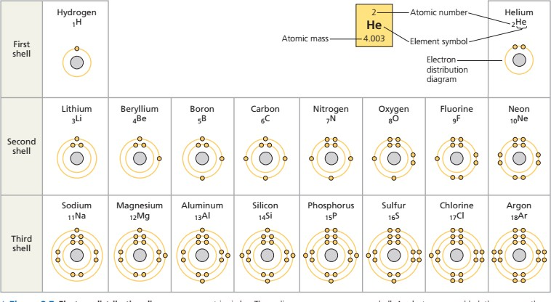
Atomic structure of first 18 elements
No of unpaired electron = Valence

Slide 21
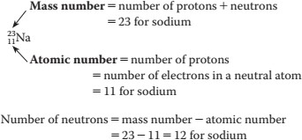
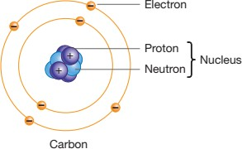
Atoms, Atomic Number, Mass Number
No of protons = No of electrons
No of Neutrons may Vary => Isotopes (Different Masses); Eg: C12, C13, C14 Mass in daltons; Eg: C12 – 12 daltons, C13 – 13 daltons

Slide 22
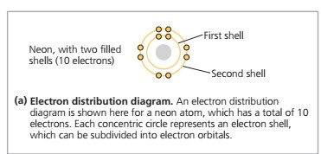
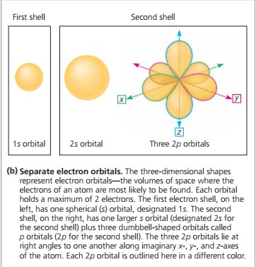
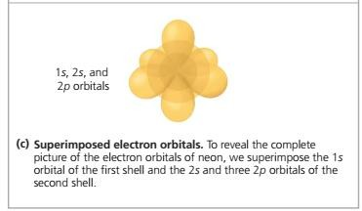
Electron Distribution, Shells, Orbitals

Slide 23
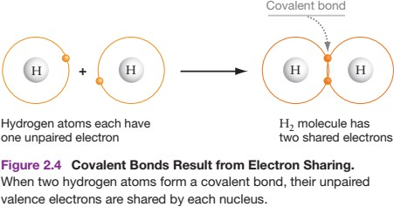
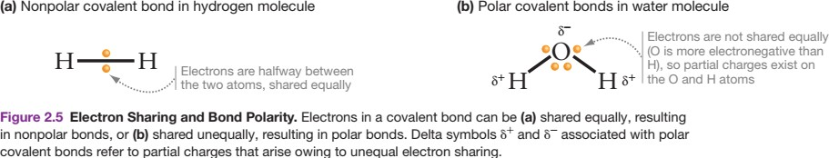
Covalent Bond
Molecules
Non polar Vs Polar Covalent Bonds
Electronegativity (O>N>C~H)
Partial charge on atoms

Slide 24
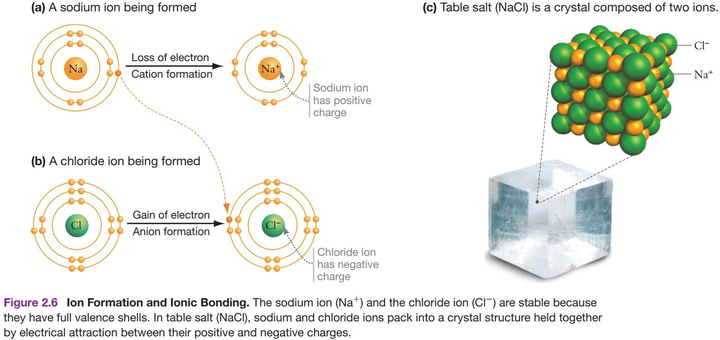
Ionic Bond

Slide 25
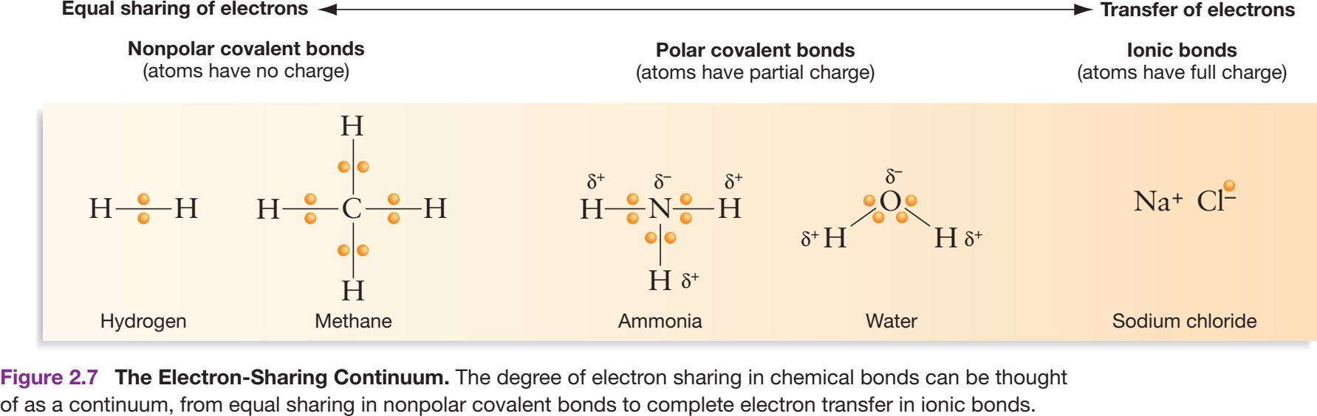
Electron sharing continuum

Slide 26
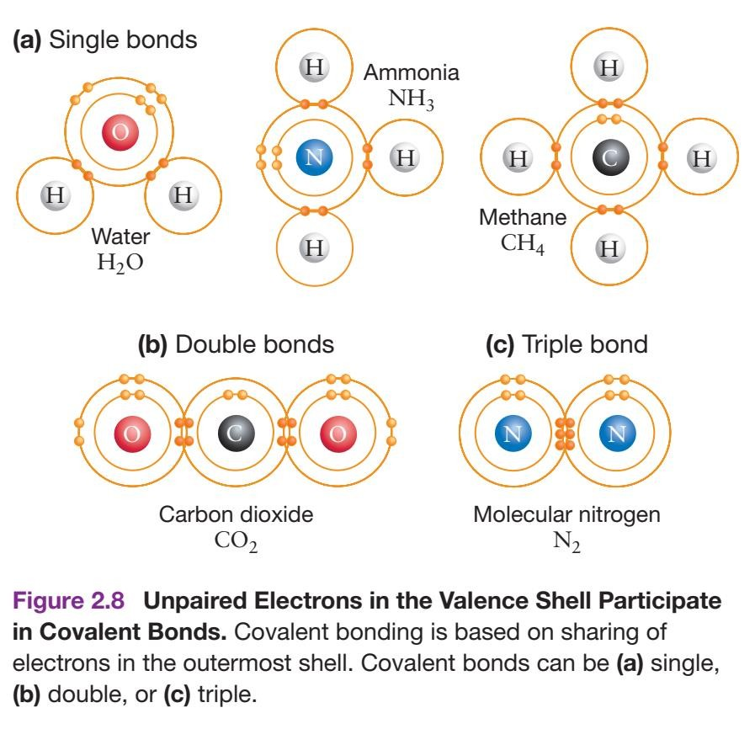
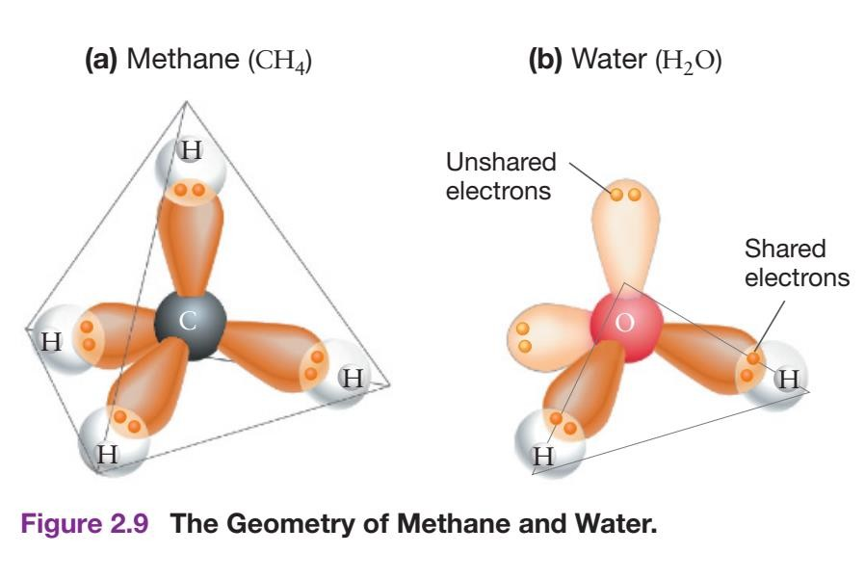
Molecules formed from C, H, N, O

Slide 27
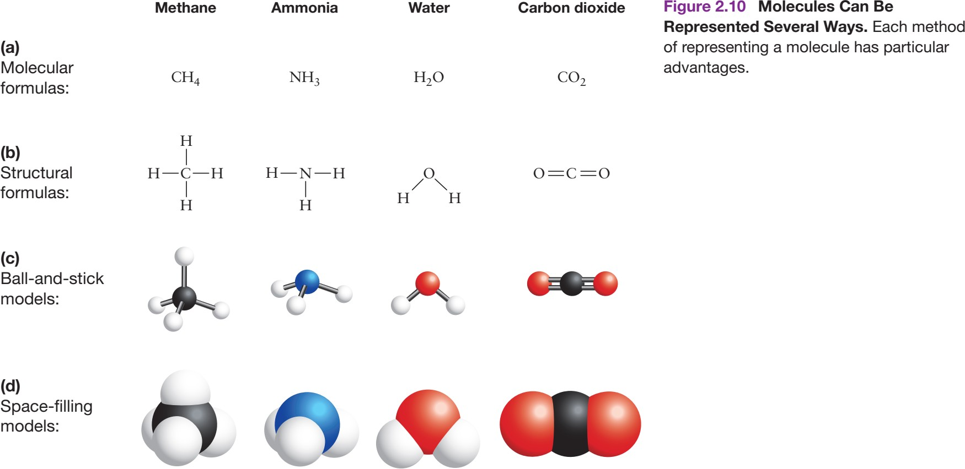
Representing Molecules

Slide 28
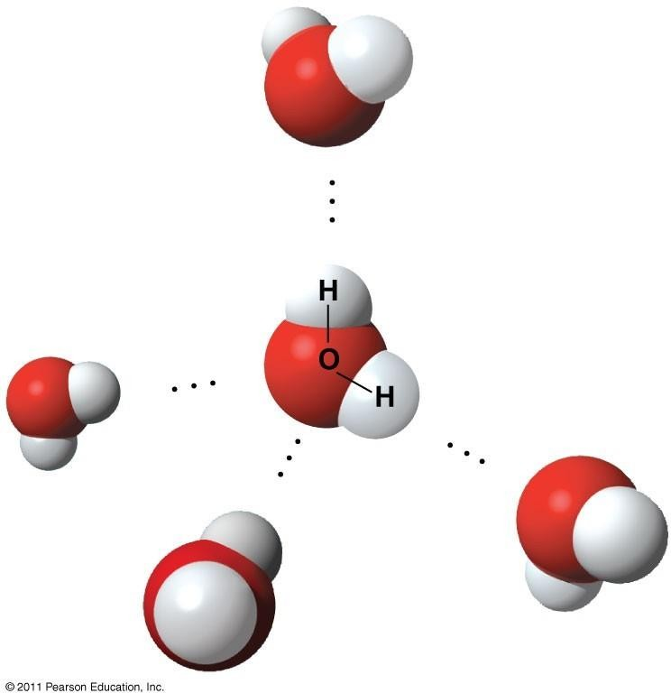
Water and Life
Life requires water; Origin
Most abundant molecule
The human body is mostly water
Lean muscle: 75% water
Blood: 83% water
Body fat: 25% water
Bone: 22% water
Properties of Water
Bent Structure
Molecule has ZERO net charge
Polar molecule – Each atom/ Opposite ends partial opposite charges
Excellent Solvent
Long to Heat/ Cool
Cohesion, adhesion, Surface tension
Hydrogen bond
^{δ− }due to week
electrical
δ+ attractions
Polar covalent bonds
δ+
δ−
δ−
δ +
δ+
δ−

Slide 29
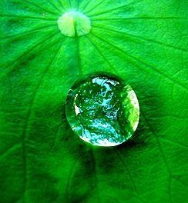

Water: Solvent of Life
Most biochemical reactions occur in water
A solution is a liquid that is a homogeneous mixture of substances
A solvent is the dissolving agent of a solution
The solute is the substance that is dissolved
An aqueous solution is one in which water is the solvent
A colloid is a stable suspension of fine particles in a liquid
Hydrophilic Vs Hydrophobic
A hydrophilic substance is one that has an water (Polar molecules/ compounds dissolve )
affinity for
A hydrophobic substance is one that does not have an affinity for water (uncharged non polar molecules of compounds – does not dissolve )

Slide 30



Cohesion, adhesion, Surface tension
Cohesion – attraction between like molecules
Adhesion - attraction between unlike molecules (often a liquid and solid surface)
Surface tension is a measure of how hard it is to break the surface of a liquid. Surface tension is related to cohesion
Water resists that increases its surface area

Slide 31

Water is denser as liquid than as a solid

Slide 32


Water has a high capacity for absorbing Energy
Hydrogen bonding
Specific Heat: The amount of energy required to raise the temperature of 1 gram of a substance by 1ºC.
Water has high specific heat
Heat of Vaporization: The amount of energy required to change 1 grams of water from liquid state to gas.
Sweating

Slide 33

Properties of Water that Facilitate Life

Slide 34


Water in Acid – Base Reactions
Water is not a completely stable molecule
H+ proton, which do not exists by themselves
Acids – give up proton to raise hydronium (H3O+) ions of water
Base – acquire protons to lowers the hydronium (H3O+) ions of water
Water is both a week acid and week base

Slide 35
Concentration of Protons
There is no simple way to count the actual number of protons
Molecular mass/ weight is the sum of all atomic weights of all molecule
Numbers of molecules are usually measured in moles
A Mole - Avogadro’s number 6.022 x 10²³ molecules
atoms in a
Molecular weight of Water = 1+1+16 = 18 (18g water = 6 6.022 x 10²³ molecules of water/ 1 mole of water)
Molarity (M) is the number of moles of solute per liter of solution
1M solution of protons in water means 1 mole of protons is contained in water
Protons measured directly in terms of Molarity and through an instrument called pH meter

Slide 36

pH of a solution reveals whether it is Acidic or Basic
Logarithmic notation
pH = - log [H⁺]
[H⁺] = antilog (-pH) = 10 ^{–pH}
H⁺ in a sample of water is 1 x 10⁻⁷M, hence pH 7
Solutions that contain acids have a proton concentration larger than 1 x 10⁻⁷M and thus pH
<7
Solutions that contain bases have a proton concentration less than 1 x 10⁻⁷M and thus pH
>7
Buffers protects against damaging changes in pH, e.g: CH₂O₃ (CHO₃⁺ and H⁺); Homeostasis

Slide 37


Chemical reactions – Chemical Evolution
The Atmosphere & Ocean(s)/deep sea hydrothermal vents
Early earth participated in chemical reactions => simple to complex organic molecules
CO₂, N₂, H₂, CO: on their own very little happens
How do chemical reactions happen?
Most common reaction possible and product precipitated in Rainwater
Mass Conservation (rearranged through chemical reactions)
Chemical equilibrium - dynamic stable state (change in reactant concentration on both sides/ temperature)
Endothermic (absorbing heat) Vs Exothermic (releasing heat) processes

Slide 38

Energy transformation is the HEART of Chemical Evolution
ENERGY: Capacity to do WORK or Supply HEAT
Stored potential – Potential Energy (position)
Chemical energy – shared electrons in bonds
Active motion - Kinetic energy Thermal energy – Molecular motion Heat – Thermal energy transfer Temperature = f (Thermal Energy)
Many forms – Change possible
I Law of thermodynamics: ENERGY is CONSERVED, it cannot be created or destroyed, but only transferred and transformed
Early earth
Gradual cooling of Molten mass (KE in the form of heat)
Electricity in the from Lightening and Sun’s radiation

Slide 39

What makes a chemical reaction spontaneous?
Chemical reactions are spontaneous if they are able to proceed on their own, without any continuous external influence, such as added energy
Two determining factors
When product molecules are less ordered than the reactant (Entrophy ) Amount of disorder: ENTROPY
Eg: nitroglycerin -> CO₂, N₂, O₂ and Water vapor
When products have lower potential energy than the reactants
II law of Thermodynamics: in all spontaneous reactions, entropy always increases when both the system and its environment are taken into account

Slide 40
Were the reactions that led to chemical evolution spontaneous?

Slide 41

Early Chemical Evolution on Earth
H₂O, CO, CO₂, N₂, H₂S and H₂
The first atmosphere (~3.8 billion years ago) probably consisted of Gaseous H, N, CO and CO2
Gaseous oxygen and water were not thought to be present
When the crust cooled the water condensed, rains began, and pools of chemicals began to
form which led to earth’s first ocean

Slide 42

Hydrothermal Vents
Chemical evolution reactions occurred ~ 3.5 billion years ago
Solvent: Water
Close physical contact
Similar reactions occurs in all living cells right this moment

Slide 43
Early origin of Life on Earth: Model Systems Proposed
With the focus on Small molecules and Environmental Conditions present at that time in early earth,
Two Different Model Systems
The prebiotic soup model
The surface metabolism model

Slide 44

1. Prebiotic Soup Model of Chemical Evolution

Slide 45

2. Surface Metabolism Model of Chemical Evolution

Slide 46

Hypothesis and Experiments
Chemical evolution Alexander I. Oparin (1924) and J. B. S. Haldane (Independently after 5 years)
Oparin–Haldane Theory
Stanley Miller’s (1953) experiment: test the prebiotic soup model

Slide 47


Miller-Urey Experiment: Prebiotic Soup
Initial Contents: 200mL water, methane CH₄, ammonia NH₃, hydrogen H₂
Nothing happened even at 100 ºC until electrical discharge to reflect ‘lightening bolts’ were sent
Early controversies => more related experiments including computer simulations
Major drawback: Dilution effects in Ocean
a Day
Week

Slide 48


Slide 49

Other Experiments
Sun light - Photons
Absence of protective Ozone
Free Radicals
Reactive precursors such as formaldehyde, HCN
Rain
Accumulation of Organic molecules with high potential energy
Building blocks for molecules of inheritance

Slide 50


Origin of First Cell… Life….

Slide 51

Carbon: Importance of Organic Molecules
Life has been called carbon based phenomenon, with good reason
Carbon bonded to other elements (H, N, O, P, S), are called Organic Compounds
Carbon – Most versatile atom on Earth,
Valence 4
Formation of Carbon-Carbon bond - Crucial step in Chemical Evolution
Organic molecules – Limitless array of molecular shapes
Different combination of single and double bonds
Functional Groups : H-, N-, O-, P-, S-

Slide 52

Six Functional Groups
1
2
3

Slide 53

Six Functional Groups (Contd..)
4
5
6

Slide 54




Life’s Large Molecules
Carbohydrates
Lipids
Proteins
Nucleic acids

Slide 55

Monomers and Polymers
Monomers (One – Part)
Small, similar molecular units
Form large molecules by condensation/ dehydration reactions
Immense variety of polymers can be made by a small set of monomers
Polymers (Many – Parts)
Long chains of monomers, result of polymerization process
Can be a straight chain or branched
Disassembles by hydrolysis reactions
Each class is formed from specific set of monomers
Every cell has thousands of different polymers (Cell Type)

Slide 56

Protein Structure and Function
Proteins – Amino Acids
Amino acids –Molecules with both a Carboxyl and Amino Group
Meteorites, Versatile components of Cells Could a protein have been the initial
spark of life?
Human body cells make tens of thousands of distinct proteins
20 different amino acids – Common core structure
R Group contributes for difference in Structure and Properties
Ionize in H₂O

Slide 57
R – Group of AAs
Affects reactivity
Hydrogen to Large Carbon structures
Contains carboxyl, sulfhydryl, hydroxyl, or amino functional groups.
sulfhydryl group (SH) can form disulfide (S-S) bonds that help link different parts of large proteins (Eg: Hair)
Affects solubility: Polar or Non-Polar R groups (Hydrophilic and Hydrophobic Amino Acids)
Grouped into 3 General types
Acid/ Basic
Uncharged Polar
Nonpolar
Structural formula at Cellular pH => Type of Amino Acid

Slide 58

AAs – Acidic/ Basic

Slide 59

AAs – Polar Side Chain

Slide 60

AAs – Nonpolar side chains

Slide 61


A recent addition – 21 AA
R group: Se in place of S

Slide 62

Classification of AAs – Multiple Ways…

Slide 63
Essential ….Semi Essential…Non-Essential AAs…
Classified based on nutritional requirements
Essential AAs: Not synthesized in the body – obtained from food 1.Methionine
Threonine
Tryptophan
Valine
Isoleucine
Leucine
Phenylalanine
Lysine
Semi Essential AAs
Arginine
Histidine
Non Essential AAs: Other 10 AAs not listed here – synthesized in body

Slide 64


Amino Acids Link to Form Proteins
Polymerization: organizes multiples simple monomers into a single complex and ordered structure
Condensation reactions
Entropy? Spontaneous? Energy?
Peptide bond: Linking AAs

Slide 65

Peptide Bonds
Carboxyl group of one AA to Amino group of another AA
Covalent C-N bond: Peptide Bond
Carboxyl to carbonyl (C=O) group and Amino becomes N-H
Stable and Planar
Residue: AAs in a Polymer

Slide 66

Peptide bond backbone – Properties
R Group orientation – Side chain interactions: amongst themselves and with H₂O
Directionality – Free Amino: N-Terminus & Free Carboxyl: C- Terminus

Slide 67

Peptide bond backbone – Properties (Contd..)
3. Flexible: Peptide bond: cannot rotate, but the single bonds of either side of the peptide bond can rotate

Slide 68
Oligo peptide…. Polypeptide…. Proteins
2 AAs: Dipeptides
3 AAs: Tripeptides
4-50 AAs: Oligopeptide (few- peptides) or Peptides
More than 50 AAs: Polypeptides (many- peptides)
Proteins
Chain of amino acids
Complete and Functional form of the molecules
Most proteins are large
Some single polypeptide
Some multiple polypeptides
Biologically active structures
Performs Life functions

Slide 69

What do Proteins Look Like?
Life
Diversity
Size
Shape (Exceptions)
Chemical properties of their AA residues
Structure=>Function
Primary
Secondary
Tertiary
Quaternary

Slide 70


Proteins - Primary Structure
Frederic Sanger (1940-50s): First Insulin
Primary Structure: Unique sequence of AAs a protein
Limitless Possibility: 20^{n} different combinatio of AAs for a polymer with a given length of n
Fundamental to Overall Structure & 1º, 2º, 3º,
in
ns
4º

Slide 71


Proteins - Secondary Structure
Interactions between functional groups in the peptide-bonded backbone.
Distinctively shaped sections that are stabilized largely by hydrogen bonding (between C=O and N-H groups )
Possible due to bend structure

Slide 72

Proteins - Secondary Structure (Contd…)
α – Helix: poly peptide backbone is
coiled (4 linear positions apart)
β – pleated Sheet: Segments of a peptide chain is bend 180º and fold in the same plane (folds brings the functional groups closer)
Ribbon diagrams
Depends on primary structure – specifically the geometry and Properties of AAs
AA Proline – rarely found in α – Helix due to its structure
Hydrogens bonds: Week when compared to covalent bonds

Slide 73

Proteins - Tertiary Structure
3D shape
..as the chain Bends and Folds..
Interactions: due to R groups - 5 types
Hydrogen bonding
Hydrophobic Interactions
van der Walls interactions
Covalent bonding
Ionic Bonding
Depends on primary and secondary structures

Slide 74

Proteins – Quaternary structure
Combination of multiple polypeptide referred to as Subunits contributes for Quaternary structure
Identical/ Non Identical subunits (dimmer, trimer, tetramer)
Macromolecular Machines: Protein assembly for particular function - Ribosome

Slide 75


Slide 76
Protein Folding and Function
Folding – Spontaneous
Folding - Contradicts II Law of thermodynamics, Unfolded protein has more ways to move about than folded proteins due to high ENTROPY than the folded version; However, equalized by chemical reactions during folding releases energy to increase the entropy in the surroundings
Folded Structure – Less potential energy & more stable
Folding and Structure: Crucial for Functioning of molecules/ a complete protein
Christian Anfinsen and Colleagues (1950s) – Structure function relationship
Studied Unfolding & Denaturation in Ribonuclease: Cleaves Ribonucleic acid
Chemical Compounds that break hydrogen and disulphide bonds
Denatured Ribonuclease No longer cleaved Ribonucleic acid
Removal of Chemicals: Reversed the Function Spontaneously
Inference: Primary sequence contains all the information for folding and folding is essential for protein function

Slide 77

Folding is Crucial to Function

Slide 78
Molecular Chaperones – Facilitates Protein Folding
Special proteins of cells that facilitates protein folding
Belong to the Family of Heat Shock Proteins
Produced in large quantity after cells experience the denaturing effects of high temperature
Recognize unfolded proteins by binding to hydrophobic patches that are not normally exposed when proteins are folded properly : Clumping of unfolded proteins is avoided
Chaperones help fold new proteins and denatured proteins

Slide 79
Protein shape is flexible
Characteristic folded shape necessary for its function
Flexible and Dynamic Shape
Over half of the analysed proteins: Inactive state-disordered regions lacking any apparent shape
Until prompted: Exists in Assortment of Shapes
What Prompts: Interactions with Ions or molecules, when chemically modified
Protein folding is often regulated: Ordered Active Confirmation
Shape determines function, hence Regulated (cell signalling processes)
Controlling and Coordinating cellular activities
Protein Function Depends on Shape: Shape depends on folding

Slide 80

Protein shape is flexible (Contd..)
Folding can be ‘infectious’
Stanley Prusiner’s (1982) surprising work on folding: Infectious Prions
Prions (proteinaceous infectious particles): Certain normal proteins can be induced to fol into infectious, disease-causing agents.
PrP: Alternate folded forms of normal proteins present in healthy individuals (same primary structure but shapes are radically different)
Eg: ‘mad cow disease’ in cattle and human: spongiform encephalopathies—literally, “sponge-brain-illnesses.”: Massive degeneration of brain
How? Transmitted while consuming PrP containing substances/ rarely inherited;
d
aggregation of Long fibrils=>death
All PrP illnesses are fatal

Slide 81
Catalysis
Transport
Defense
Protein
Functions
Movemen t
Structural
Signaling

Slide 82
Protein Functions – Diverse
More cell functions than any other type of molecules
Vital for Life - Life began with proteins
Eg: Red blood cell: each contains 300 million copies of hemoglobin (carries O₂); thousands of carbonic anhydrase (CO₂ from tissues to Lungs)
Catalysis: Speed up reactions; A protein that functions as a catalyst is called an enzyme. Eg: Salivary Amylase, hemoglobin, carbonic anhydrase
Catalytic function most important: Most chemical reactions that make life possible depend on enzymes

Slide 83

Protein Functions – Diverse (Contd…)
Enzymes are most effective catalyst on earth Why Are Enzymes Good Catalysts?
Substrate: Reactants of catalysed reactions
Enzymes hold substrate in a precise orientation
How enzymes work?
Emil Fischer (1894): Lock and Key Model
Enzyme’s Active Site: the location where substrate binds to an enzymes, clefts or cavities within the overall shape of the protein
Did Life Arise from a Self-Replicating Enzyme?
Skeptical: To achieve the attributes of life, proteins would need to possess information, replicate, and evolve (..cannot on their own..)

Slide 84

Protein Functions – Diverse (Contd…)
Defense: Immune system: Antibodies attack and destroys disease causing bacterial & viruses
Movement: Motor protein and contractile proteins
- Cell movement & Moving large molecules and other types of cargo inside the cell. Eg: Actin and Myosin
Signaling: Carrying and receiving signals from cell to cell inside the cells; Reside at cell membrane; Eg: Glucagon: detects low sugar binds to receptors on liver cells to trigger release of sugar into your blood.
Structure: Structural proteins make up body components and internal skeleton of every cell; Eg: finger nails and hair; hemoglobin
Signaling - Ref: Chiarini et al., 2015;
Transport: Enter or Exit the cells/ organ system; Eg: Membrane proteins that control the passage of specific molecules and ions
Trends Pharmacological Sciences, Vol 36 (2)

Slide 85
Catalysis
Transport
Defense
Protein
Functions
Movemen t
Structural
Signaling

Slide 86

Nucleic acids and RNA world
Life began when chemical evolution led to production of a molecule that could
promote its own replication
Cells stores genetic information – deoxy ribonucleic acid (DNA); DNA is replicated using proteins
RNA world hypothesis proposes that there was a stage in the
evolution of life when ribonucleic acid (RNA) both stored the genetic information and catalyzed its own replication
Evidence available
Nature of the first “living molecule”: subject of many investigations and debates
Evolving molecules: Before RNA?
RNA: Before DNA and Proteins?
Chance errors in copying process => Variants => Natural selection
Biological evolution by natural selection began?

Slide 87

What are Nucleic Acids?
Polymers of Nucleotide
Components of Nucleotide: a phosphate group, a five carbon sugar, a nitrogenous base

Slide 88
Nucleotides
Sugar: central component; 5 carbons – labelled with ’ (prime) symbols to provide
a frame of reference
Nitrogenous Base: attached to 1’ Carbon of sugar;
Purines (A, G)
Pyrimidines (C, U, T)
Purines are larger than pyrimidines due to their two ring structure formed from 9 carbons
Phosphate group: attached to the 5’ Carbon of sugar
Two types of Nucleotides:
Ribonucleotides are the monomers of ribonucleic acid (RNA)
deoxyribonucleotides are the monomers of deoxyribonucleic acid (DNA)
What is the difference?
RNA: Ribose Sugar - 2’ Carbon has a OH group attached to it; Use Pyrimidine U
DNA: deoxy Ribose Sugar - 2’ Carbon has a H attached to it; Use Pyrimidine T

Slide 89
Could Chemical Evolution Result in the Production of Nucleotides?
Miller like experiments
Minerals preferentially bound to Ribose – enriching Ribose in a pool of diverse sugars
Did it occur at ancient hydrothermal vents?
Whether nucleotides were produced during the early earth?
Experiments that attempt to simulate early Earth environments have yet to synthesize complete nucleotides

Slide 90


How Do Nucleotides Polymerize to Form Nucleic Acids?
Condensation reactions: Hydroxyl group on sugar component (3’) of one nucleotide and Phosphate group of another nucleotide
Phosphodiester linkage or bond+H₂O
linking ribonucleotides: RNA
linking deoxyribonucleotides: DNA
Chain of Phosphodiester linkage acts as a Back bone: Sugar phosphate backbone
Chain of nucleotide polymer referred to as Strand
RNA: Single stranded
DNA: Double stranded

Slide 91

DNA and RNA strands are directional
Sugar phosphate backbone is directional
In a strand one end has unlinked 5’ phosphate and the other end has an unlinked 3’ hydroxyl group
Convention 5’->3’ direction
In cells both RNA & DNA are synthesized in this direction
Nucleotides added only at 3’ end of a growing
molecule
Writing the sequence short letter of bases
Eg: DNA sequence consisting of 6 nucleotides might be ATTAGC (6 billion of this letters: Human)

Slide 92

Energy for the polymerisation reaction
Could nucleic acids have formed in the absence of enzyme?

Slide 93

DNA Structure and Function
Anti parallel double helix (Watson and Crick., 1953) – X ray diffraction data
Chargaff ’s Rules

Slide 94

DNA Structure and Function (Contd…)
Structure highly stable
Regular, Symmetric
Withstand wide array or T, pH &
chemical conditions. Eg: Fossils
Non reactive

Slide 95
DNA functions as an information containing molecule
All organisms (tiny bacteria to redwood tree): DNA stores information
Templates
Growth, reproduction, hereditary information
Stable Structure and Non reactive
DNA copying is basis for life
Chemical evolution => Evolution by natural selection Switching
No support for the hypothesis that the first life form consisted of DNA alone
Most biologists who are working on the origin of life support the hypothesis that life began with RNA

Slide 96


DNA Replication

Slide 97

RNA Structure and Function
First living molecule: 2 key functions
Carry information
Catalyse reactions to promote its own replication
How? RNA and its Structure
Primary structure: Sequence of 4 bases (A, U, G, C) in sugar phosphate back bone
Sugar: Ribose (2’C -OH group): Less stable than DNA
Secondary structure: Complementary base pairing in same strand: Hairpin
Single strand: stem-and-loop
Spontaneous structure formation: Length and arrangement of base pairs

Slide 98


Slide 99

RNA’s Versatility
Array of function
Folds into complex 3D shapes much like protein
Structural flexibility
Types based on function
mRNA: Protein synthesis
tRNA: AA carrier in protein synthesis
rRNA: aids in polypeptide bond formation, assembly of AAs
Hypothesis: Major role in Origin of Life
Can function as catalytic molecule: RNA enzymes or ribozymes (Sidney Altman and Thomas Cech:1989 Nobel Prize)
Tedrahymena ribozymes: perform both hydrolysis & condensation reactions
Other catalytic role explored

Slide 100

RNA World may have Sparked the Evolution of Life
RNA: copy itself & Catalytic role
David Bartel’s Experiments: replicase mutants – large pool of structure and function
Ribozymes that could catalyze the production of nucleotides would be more likely to be copied due to local accumulation of monomers.
Ribozymes: Essential for proteins synthesis in all organisms (no ribozymes -> no life forms)
Fulfills 3 of 5 characteristics of life
Information processing
Replication
Evolution
Possible on early earth by utilizing chemical energy

Slide 101
Carbohydrates
Sugar
Organic compounds, molecular building block
Energy source (Immediate usage/ Stored for later use)
Monosaccharide (one-sugar)
Disaccharide (two-sugar)
Oligosaccharide (few-sugar)
“Carbohydrate” Name is logical: Molecular formula (CH₂O)_{n}
where, ‘n’ indicates the number of carbohydrates &
n varies between 3 for smallest sugar and 1000s of molecules for large polymers
C, H, O in a Specific Ratio, 1C:2H:1O
Made up of a carbonyl (C=O), several hydroxyl (-OH) along with multiple (C-H)

Slide 102

Sugar Molecules
Main fuel supply for cellular work, especially
glucose
Cells break down sugar molecules and extract the stored Energy
Cells use the carbon skeletons of monosaccharides as raw materials for other organic molecules

Slide 103

Carbohydrates – Classification

Slide 104
Monosaccharides
Simple sugars - one sugar unit
Fundamental during early chemical evolution (Eg: Ribose)
Aldehyde Sugar: Aldoses (carbonyl group at the end)
Ketone Sugar: Ketoses (carbonyl group in the middle)
Smallest Sugar C₃H₆O₃
Reactive, Hydrophilic and Polar Molecules
No of C molecules Varies Among Monosaccharides
Triose (3C), Pentose (5C), Hexose (6C)
Spatial arrangement of atoms -> Different Structure (Different Sugar); Eg: C₆H₁₂O₆ (Glucose/Fructose/ Galactose)
Structure difference -> Functions Different
In cells, Glucose: Source of Carbon, utilized for energy requirements and to synthesis large molecules

Slide 105


Slide 106

It is rare for sugars consisting of five or more carbons to exist in linear chains –
they spontaneously form ring structure in aqueous solution

Slide 107


Slide 108
Can Monosaccharides Form by Chemical Evolution?
Laboratory experiments in this direction have shown that when CH₂O was heated in solution they reacted with one another to form almost all possible types of pentoses and hexoses
Reflects undersea volcanos and hydrothermal vents
3-C Ketose found in Meteorite that struck Murchison, Australia (1969)

Slide 109


Polysaccharides
Complex carbohydrate: short oligosaccharides to long polysaccharides
Condensation reaction: Monosaccharide polymerize to form a glycosidic linkage, between two hydroxyl groups; Hydrolysis reverses to yield monomers
Carbohydrates: function depends on structure/ monomers and how they are linked
How they are formed? Radically different usage
To store chemical energy in the cells of plants
To provide structural support in the exoskeletons of insects

Slide 110

Disaccharides
Using a dehydration/ condensation reaction, cells put together 2 monosaccharides to make one disaccharide
Most common disaccharide is sucrose
Maltose (2 glucose molecules); α – 1, 4 glycosidic linkage
Lactose (glucose and galactose ); β –
1, 4 glycosidic linkage
No’s refer to C’s on either side of the
linkage, in both between C1 and C4
α and β refer to the contrasting orientations of the C-1 hydroxyls —on opposite sides of the plane of the glucose rings (i.e., “below” versus “above” the plane).
Enzyme specific to cleave maltose will
not cleave lactose into its monomers
Lactose: Lactase; human stop secreting after childhood -> lactose intolerance

Slide 111


Sucrose
Glucose + Fructose
Major carbohydrate in plants,
so…
Nourishes plants
Table sugar is extracted from stems of sugar cane or roots of sugar beets
Can be broken down and used as soon as consumed
Or can be stored

Slide 112
Most common polysaccharides
Polysaccharides: long polymer chains made up of simple sugar monomers
Most common examples:
Starch
Glycogen
Cellulose
Chitin
Peptido glycon (Slightly modified)
Structure function relationship

Slide 113
Starch
Found in plants, polymerized and stored for later use
Composed of α-glucose monomers, joined by glycosidic linkages between C1 and C4 carbons, the angle of these bonds causes the chain of glucose residue to coil into helix
Unbranched – Amylose
Branched – Amylopectin; Branching occurs when glycosidic linkages are formed between C1 and C6 carbons, at about every 30 glucose residues
Humans can break down starch unto useful energy
Examples of foods rich in starch:
Potatoes
Rice
corn

Slide 114

Starch and Glycogen

Slide 115
Glycogen
Highly branched storage polysaccharide in animals
In humans, cells of liver and muscle tissues, Exercise breaks these down to glucose which provide energy
Helical form of glucose, nearly identical to starch
α-1, 6-glycosidic linkages are formed between C1 and C6 carbons, at about every 10 glucose residues

Slide 116

Cellulose
In plants, the major component of cell wall
Made of β-glucose monomers, joined by β-1, 4- glycosidic linkages
Geometry of the linkage is such that each glucose residue in the chain is flipped in relation to the adjacent residue
generates a linear molecule, rather than the helix seen in starch;
permits multiple hydrogen bonds to form between adjacent, parallel strands of cellulose
As a result, cellulose forms long, parallel strands that are joined by
hydrogen bonds => fiber/ cable
Functions
A building material in plants
Protect cells
Stiffen plant so it doesn’t fall over

Slide 117

Cellulose

Slide 118

Cellulose
Most animals cannot digest cellulose
Why?
So…
Passes through body unchanged
It is NOT a nutrient
Cows and termites can digest cellulose…
How?

Slide 119

Chitin
Structural polysaccharide in fungi and animals (protists and animals )
Stiffens the cell wall
Important component of the external skeletons of insects and crustaceans
Made of N-acetylglucosamine (NAG) monomers, joined by β-1, 4- glycosidic linkages => flipped orientation, Hydrogen bonds between adjacent strands => Stiff protective armour

Slide 120

Peptidoglycan
Structural polysaccharide of bacteria, present in cell walls
Most complex: a long backbone formed by NAG and N-acetylmuramic acid (NAM) that alternate with each other and are linked by β-1,4-glycosidic linkages, along with a short chain of amino acids which is attached at the C-3 carbon of NAM
When molecules of peptidoglycan align, peptide bonds link the amino acid chains on adjacent strands

Slide 121
Polysaccharides and Chemical Evolution
Virtually all organisms depend on glycogen or starch to store chemical energy
Polysaccharides probably played little to no role in the origin of life
Under the conditions prevailed on early earth’s history
No plausible mechanism for polymerization of monosaccharides
No catalytic role
No self replication
They are important once after cellular life evolved

Slide 122
What do carbohydrates do?
Substrates for more complex molecule formation (Eg: DNA, RNA)
Furnish the ‘carbon skeleton’ as building blocks for synthesis of important
cellular components
Carbohydrates
provide fibrous structural materials
indicate cell identity
store chemical energy
ALMOST all carbs are hydrophilic because of –OH groups
Mono- and disaccharides dissolve easily in water
Cellulose and some starches do not dissolve in water (even though they are hydrophilic) => Textile Industry

Slide 123
1. Structural Support
Cellulose & Chitin => Fibers: Strength and Elasticity
Fibers crisscross => tough Sheets; Durable, withstand pulling and pushing forces
Only a few organisms have enzymes capable of digesting cellulose, chitin, or peptidoglycan
Insoluble: β-1, 4 glycosidic linkages; resistant to decay and degradation
Cellulose, indigestible but absorbs water: This sponge-like adds moisture and bulk that helps fecal move through the intestinal tract more quickly, preventing constipation and other problem

Slide 124

2. Cell Identity
Structural polymers tend to be repetitive, made up of one or two types of monosaccharides
Some, display enormous structural diversity
Display information through their structure – As identification badge on outer surface of plasma membrane
Attached to lipids and proteins – project outwards into the environment
Glycolipid & Glycoprotein (glycosylated): one or more covalently bonded carbohydrates: Cell-cell recognition & signalling
Egs: Blood type determined by oligosaccharides present on the outside; Each type of cell in human body display different set of glycoproteins on its surface; Species specific recognition of sperm and egg cells- Paul Wassarman and colleagues competitive inhibition assays

Slide 125


Slide 126

3. Energy Source
Carbohydrates store and provide chemical energy in cells
Store sunlight as chemical energy: plants harvest the energy in sunlight and store it in the bonds of carbohydrates by the process known as photosynthesis
Because C-C and C-H bonds have much higher potential energy than C-O bonds, carbohydrates store much more chemical energy than CO₂

Slide 127

Potential energy is stored in the bonds of the molecules
C-C and C-H bonds have high potential energy because the atoms have low electronegativities and share the electrons equally.
C-O bonds, in contrast, have low potential energy because the highly electronegative oxygen atom holds the electrons so tightly, resulting in a stronger bond.
Potential energy in bonds is released when they are broken
Both carbohydrates and fats are used as fuel in cells, but fats store twice as much energy per gram compared with carbohydrates.

Slide 128
Enzymes hydrolyse polysaccharide to release glucose
Starch and Glycogen: effective energy storage molecules (α glycosidic bonds)
α glycosidic linkages readily hydrolysed compared to β glycosidic linkages
(resist’s enzymatic hydrolysis)
Phosphorylase : α glycosidic linkages in glycogen
Amylase (Salivary glands & pancreas): α glycosidic linkages in starch
Glucose released is processed further to produce chemical energy

Slide 129
Energy stored in glucose is used to make ATP
Energy captured through synthesis of ATP during glucose breakdown/ glycolysis
ATP is synthesized form a precursor ADP plus a free inorganic phosphate (Pi) molecule
Energy stored in C-H, C-C bonds of carbohydrates are released as C=O bonds are formed. This energy is then transferred to ATP through a new bond
Energy in the form of ATP drives reactions that are responsible for everything from polymerization to muscle movement

Slide 130
Lipids, Membranes and First Cells
Emergence of membrane – important milestone in Evolution
Plasma membrane/ Cell membrane: Layer of molecules that surrounds and separates the cell interior from the environment (Separates life from non life)
Serves as a selective barrier: keeps damaging substances out of the cell & allows entry of substances needed by the cell
Enclosed area for reactants to collide more frequently, life reactions to occur more efficiently
How? What? Which? & Why?

Slide 131

Lipid Structure and Function
Largely Non polar & Hydrophobic
Dissolve in nonpolar organic solvents such as benzene
Entirely carbon atoms bonded to hydrogen atoms/ hydrocarbons
Isoprenoid: pigments, scent, vitamins, building blocks for complex lipids and precursors of sex hormones

Slide 132



Fatty Acids
Hydrocarbon chain bonded to a carboxyl (-COOH) functional group
Single bonds between C: Saturated
One or more double bonds between C: Unsaturated (poly Unsaturated)
Typically contain a total of 14-20 C atoms (long hydrocarbon tails)
Building blocks of lipids
Type of bond between carbons in hydrocarbon chains - a key factor in lipid structure and function
-C=C-, cannot rotate freely, produce a kink (sometimes, cis bonds)
Foods with poly unsaturated fatty acids: healthier than saturated; Protect the heart form disease: Mechanism unknown
Highly saturated lipids, high melting points and solid at room temperature Eg: Butter, Beeswax
Highly unsaturated lipids: liquid at room T; Eg: Vegetable oils

Slide 133

Hydrogenation breaks the double bonds: Unsaturated oil to Saturated lipids

Slide 134
Types of Lipids found in Cells
Lipids are characterized by a physical property: insolubility in Water
Insolubility: high proportion of non polar C-C and C-H bonds
Lipids structure vary widely depending on bond structure and hydrocarbon length
Three types
Steroids
Fats
Phospholipids
Each type differs in structure and function

Slide 135

1. Steroids
Bulky Four ring structure
Hydrophobic rings
Functional or side group
Estrogen, testosterone: Signalling
Cholesterol – hydrophilic OH at top ring and an isoprenoid tail at bottom: important component of plasma membranes

Slide 136

2. Fats
3 Fatty acid molecules linked to a 3-C molecule Glycerol: Triglycerides
Nonpolar
If glycerol liked fatty acids are
polyunsaturated they are called oils
Primary role: Energy storage
Formed by Dehydration reaction between the hydroxyl groups of glycerol & carboxy group of free fatty acids: Ester linkage
Fats are not polymers and fatty acids are not monomers

Slide 137

3. Phospholipids
A glycerol linked to a phosphate group and two hydrocarbon chains of either isoprenoids or fatty acids
Phosphate group is also bonded to a small organic molecule that is charged or polar
PLs with fatty acid tails found in the domains of Bacteria & Eukarya
PLs with isoprenoid tails found in the domain of Archaea (provide greater membrane stability and protection in the extreme environments)
PLs: crucial components of plasma membrane

Slide 138
Membrane lipids interact with water
Lipids acts as
Pigments that capture or respond to sunlight
Serves as signals between cell
Forms water proof coatings on leaves and skin
Acts as vitamins
Forms cell membranes (Not all lipids can form membranes)
Membrane-forming lipids have a polar, hydrophilic region
“head” region containing a negatively charged phosphate group attached to a polar group; Charges and polar bonds in the head region interact with water molecules when a phospholipid is placed in solution
Long hydrocarbon “tails” of a phospholipid are nonpolar and hydrophobic
Phospholipids are amphipathic (literally, “dual-sympathy”): contain both hydrophilic and hydrophobic regions. Eg: Cholesterol
Biologically most important feature – Plasma membrane

Slide 139
Were lipids present during early Chemical Evolution?
There is evidence that lipids were present during chemical evolution
Lab Experiments: possible to synthesize simple lipids such as fatty acids from H₂ and CO₂ via mineral catalysis reactions
Prebiotic hydrothermal vent environment
Lipids literally from sky: Modern meteorites
Lipids extracted from the meteorite that struck Murchison, Australia, in 1969 spontaneously formed lipid “bubbles” that resembled small cells
Why? bubbles

Slide 140

Phospholipid Bilayers
Amphipathic lipids when placed in water forms
Micelles or Lipid bilayers
Hydrophilic head interacts with water
Hydrophobic tails do not
Micelles
Tiny aggregates
Heads form hydrogen bonds with water
Tails interact with each other in the interior
Fatty acids or simple lipids
Lipid bilayers / phospho lipid bilayers
Aligned in paired sheets
Hydrophilic head in each layer face the surroundings
Tails face one another inside the bilayer
Phospholipids contains bulky 2 hydrocarbon tails
No input energy is required

Slide 141

Artificial membranes – Experimental systems
How membranes work? Experiments on artificial membranes in labs
Phospholipids in an aqueous solution when agitated form vesicles: small bubble-like structures consisting of lipid bilayers surrounding a small amount of aqueous solution
Liposomes: Artificially generated membrane-bound vesicles
Mimics a membrane bound cell
Another experiment: Planar bilayer (2D model)
To test, Permeability: tendency to allow a given substance to pass through it
Ion and molecule transport, How? How Rapid? Does permeability change when other types of molecules such as proteins are present?
Elegant and powerful experimental system

Slide 142

Selective permeability of Lipid bilayers
Highly selective: Some substances cross a membrane more easily than other substances
Small nonpolar substances move quickly across the lipid bilayer; if polar the rate decreases
Larger polar molecules and charged substances cross the membrane even slower
Controlling Exterior/ interior transfer
Oxygen (O₂) move a billion times faster than chloride ions(Cl-)
Ions cannot cross without help

Slide 143

Size and polarity or charge affect the rate of diffusion across a membrane

Slide 144

Does Lipid Structure Affect Membrane Permeability? How?
All phospholipids bilayers are not the same
Length and saturation state of the tails and
presence of cholesterol profoundly
influence the physiological characteristics
and its permeability
Membrane fluidity
Spaces among tails reduce van der Walls
interactions (unsaturated hydrocarbons, kinks due to double bonds)
Packed saturated hydrocarbons non space,
higher van der Walls interactions; strong and dense membranes
More permeable as well as more fluid
when they contain many short, kinked, unsaturated hydrocarbon tails
Cholesterol reduces membrane permeability

Slide 145



Slide 146

Does Temperature Affect the Fluidity and Permeability of Membranes? How?
Oil like texture: lipid molecules to move laterally within each layer (2μm/s)
Anology: a perosn moving in a heavy crowd
At very low temperatures, lipid bilayers even begin to solidify=> reduced transportation
As temperature increases permeability increases

Slide 147


How Substances Move across Lipid Bilayers?
Small uncharged hydrophobic molecules
Diffusion
Spontaneous movement of
molecules and ions is
known as diffusion
Net movement, due to
concentration gradient:
Difference in solute concentrations
High to low concentrations
Passive transport
Osmosis
Movement of water
Occurs only when solutions
are separated by a membrane
that permits water to cross
Low to High solute concentrations
Solute concentration and Change in volume

Slide 148

Osmosis Can Shrink or Burst Membrane-Bound Vesicles
Solute or Water
Low Excess
movement

Slide 149


Membranes and Chemical Evolution
Proto cells: Simple vesicle-like structures that harbor
nucleic acids & essential monomers
Possible intermediate in evolution of cell
Diffusion & Osmosis to reduce chemical composition between and inside and outside
Interior not radically different from exterior
Container for replicating RNA molecules – question of monomer availability
Can negatively charged ribonucleotides
get across lipid bilayers and inside lipid-bounded
vesicles? Yes
Jack Szostak and colleagues experiments
Free lipids and micelles can be incorporated into fatty acid bilayers enabling proto cells grow
Shearing forces, as from bubbling, shaking, or wave action, cause protocells to divide

Slide 150

Proteins Alter Membrane Structure and Function
Selective permeability: Proteins in Lipids bilayer
Proteins can be amphipathic, can form openings or selective channels/pores
Chemical composition analysis of plasma membranes => proteins and PLs

Slide 151


Fluid Mosaic Model
Hugh Davson and James Danielli (1935): Cell membranes structured like
sandwich in which hydrophilic proteins coat both sides of a pure lipid bilayer
S. Jon Singer and Garth Nicolson - an alternative hypothesis: some proteins span the membrane instead of being found only outside the lipid bilayer
Fluid Mosaic model: Membranes are dynamic and fluid mosaic of phospholipids and different types of proteins; widely accepted model
Freeze-fracture electron microscopy/ scanning electron microscopy (1970s)

Slide 152

Fluid Mosaic Model (Contd…)
Enables to view the middle
Pits and Mounds studded the interface: locations of membrane proteins
Integral membrane protein/transmembrane protein: proteins that span the membrane
Peripheral membrane proteins: proteins that bind to membrane lipids or integral membrane proteins without passing through it (specific to cell interior or exterior)
Distinct cell interior and exterior
Proteins affect permeability of the membrane. How?

Slide 153

Systems for studying membrane protein
Isolate transmembrane proteins to study permeability
Detergents are utilized to isolate transmembrane protein
Detergent: small amphipathic molecules that form micelles in water
Water soluble
Three broad classes of transmembrane proteins
Channels
Carriers
Pumps

Slide 154

1. Channels
Ions cross membranes routinely by Ion channels
Pores or Openings: diffusion through these pores
Predictable direction: from regions
of high concentration to regions of low concentration and from areas of like charge to areas of unlike charge
Electrochemical gradient: ions diffuse in a directional manner
Net negative or positive charge on either side
Highly Selective: Aquaporin (Only water)
Cystic fibrosis: Cl^{-,} thick mucus, clogging
Gated Channel: pores open/ close according to a specific signal
Facilitated diffusion

Slide 155

Voltage gated K⁺ channel
Note the protein open and close configuration

Slide 156

2. Carrier Proteins Facilitate Diffusion
Facilitated diffusion, concentration gradient
Channel proteins undergo shape changes that selectively pick up a solute on one side of the
membrane, then drop it off on the other side. Eg: Glucose transporter, GLUT-1

Slide 157
3. Pumps Perform Active Transport
Cells to move molecules or ions in a directed manner, often against an existing gradient
Active transport: Transport against gradient
Active transport proteins => Pumps
Needs Energy to Counter act the decrease in Entropy when ions and molecules are concentrated
ATP: When a Phosphate group is transferred to the pump, pumps potential energy increases and its shape changes
Eg: Sodium potassium pump; Proton pumps, Calcium pumps
To import and concentrate valuable nutrients within cells

Slide 158





Slide 159

Plasma membrane define the intracellular environment
~ 30% of ATP is utilized for this process

Slide 160
Reference
Allison Scott Freeman, Kim Quillin and Lizabeth Allison, Biological Science, Pearson Education India, 2016
Reinhard Renneberg, Viola Berkling and Vanya Loroch, Biotechnology for Beginners, Second Edition, 2016
Acknowledgements
Dr. Asim Bikas Das, Dr. Rama Raju, Dr. Shyam Perugu, Dr. M. Jerold Department of Biotechnology, NITW
Dr. Seenivasan Ayothiraman, Department of Biotechnology, NIT Andhra

